Slide 1
FINAL PROJECT PRESENTATION
65,535
loans analysed
Bank Loan &
Debit–Credit Analytics
100,000
transactions analysed
EXCEL POWER BI SQL TABLEAU
3
BI tools used
Nalinikanta Dash | Data Analyst

Slide 2





Introduction
Bank Loan Analytics
Debit & Credit Analytics
Portfolio of 65,535 microfinance-style loans across 112 branches
Tracks funding, collections, interest income and repayment risk
Built in Excel (pivots, slicers, VBA), Power BI and Tableau
100,000 INR transactions across 6 banks and 6 branches in 2024
Tracks credit vs debit flow, methods, trends and high-risk activity
Built in Excel, Power BI and Tableau with matching KPIs
Excel
Power BI
Tableau
Pivot tables, slicers, VBA macros, dashboards
DAX measures, 2-page interactive report
Calculated fields, KPI and chart sheets

Slide 3

Data Overview
Loan portfolio dataset
Debit & credit dataset
Records
65,535 loans, 55 fields
Records
100,000 transactions, 14 fields
Period
Disbursed Nov 2016 – Feb 2020 (FY17–FY20)
Period
Jan – Dec 2024 (Dec has only 305 rows)
Coverage
112 branches, 11 regions, 15 states
Coverage
6 banks × 6 branches, all in INR
Value
₹751.0M loan amount, ₹732.7M funded
Value
₹254.9M total, ₹100 – ₹5,000 per txn
Borrowers
99.96% women (65,511); age 18–62
Methods
Bank transfer, credit card, debit card
Key fields
Grade, term, status, purpose, interest, repayment
Quality
No nulls, no duplicates, no negatives
Data-quality flags: 39% of loans have no grade, verification or home-ownership value; disbursement dates use mixed formats; every transaction has a unique Customer ID.

Slide 4
Objective
Loan portfolio
Debit & credit transactions
1
Measure portfolio size, collections and interest income
1
Measure credit vs debit flow and the net position
2
Quantify delinquency and default risk
2
Compare banks, branches and payment methods
3
Find where lending is concentrated: state, branch, product, borrower
3
Understand how activity moves month by month
4
Track disbursement growth across financial years
4
Surface high-risk transactions for review

Slide 5
KPIs
Loan KPIs
Debit & credit KPIs
₹732.7M
65,535
₹254.9M
₹127.6M
Total funded amount
Total loans
Total transaction amount
Total credit
₹814.9M
₹155.3M
₹127.3M
1.0025
Total collection
Interest received
Total debit
Credit-to-debit ratio
10.84%
1.56%
100,000
20.4%
Delinquent loan rate
Default loan rate
Transactions
High-risk transactions
Also tracked: total revenue ₹156.6M (interest + fees + late fees), recoveries ₹6.5M, average loan ₹11.5K, average interest rate 12.03%, net credit–debit ₹0.32M, activity ratio, transactions per day/week/month, customer count.

Slide 6




Process
1. Collect
2. Clean & prepare
3. Model
4. Define KPIs
5. Visualize
6. Insight
Loan file (65,535 rows) and transaction file (100,000 rows)
Fix types and dates, handle blanks, standardise labels
Pivot tables, data model, DAX measures, Tableau calculated fields
10+ loan KPIs and 8 transaction KPIs, same logic across tools
Excel dashboards with slicers, Power BI report, Tableau sheets
Interpret patterns and turn them into recommendations
Cross-checked: loan KPIs reconcile between the raw data, Excel pivots and the dashboard cards (₹732.7M funded, 65,535 loans, ₹814.9M collected).

Slide 7
Analysis: Loan Portfolio
Funded amount by state (₹M)
Delinquency vs interest rate by grade (%)
Funded amount by financial year (₹M)
Four states (UP, Punjab, Bihar, Haryana) hold 58% of funding. Home loans are the top purpose at 37%.
Risk climbs steadily with grade: 3.9% delinquent at A versus 26.0% at G, and pricing rises from 7% to 21%.
FY19 was the peak year with 57% of all funding. FY20 is smaller because the data stops at Feb 2020 (11 months).

Slide 8
Analysis: Debit & Credit Transactions
Monthly transaction amount (₹M)
High-risk share of transactions (%)
Amount by branch (₹M)
Steady ₹22–24M a month; February dips with fewer days. *December holds only 305 rows, so it is not a real drop.
High-risk transactions are 20% of volume but 36% of value. The flag is simply amount ≥ ₹4,000 (avg ₹4,507 vs ₹2,046).
Branches, banks and methods are almost identical (within about 3%), so no single channel stands out.

Slide 9
Insights & Recommendations
Key insights
Recommendations
Risk rises sharply with grade
Grades D–G are 30% of graded funding and run 17–26% delinquency, against 4% for grade A.
Tighten pricing and limits for grades D–G
Add early-warning follow-up for E–G accounts; review approval rules for these grades.
1
1
60-month loans earn more but default more
14.9% average rate vs 10.8%, with a 2.05% default rate vs 1.35% for 36-month loans.
Review the 60-month product
Weigh the extra yield against the higher default rate; consider tighter eligibility.
2
2
Lending is concentrated
UP, Punjab, Bihar and Haryana take 58% of funding; Haryana (10.0%) and Odisha (10.2%) have the lowest delinquency of the large states.
Grow where risk is lower
Prioritise Haryana and Odisha, and reduce reliance on four states.
3
3
Transaction flow is balanced, risk flag is blunt
Credit-to-debit is 1.0025, and the high-risk flag only checks amount ≥ ₹4,000.
Make data and risk rules stronger
Require grade and verification fields; add behaviour-based rules (frequency, new payees) to the amount flag.
4
4

Slide 10
Conclusion
1
2
3
Healthy, well-collected book
Risk is predictable
Transactions are balanced
₹814.9M collected on ₹751.0M of loans; 89% of funded principal already recovered.
Grade and loan term explain most of the difference in delinquency and default.
Credit and debit flows match closely; the risk flag needs richer rules.
Tying the same KPIs across Excel, Power BI and Tableau gave one consistent view of both portfolios and a clear list of next steps.

Slide 11


Challenges & Learning
Challenges
Learning
Heavy files and messy fields
127 MB workbook with a million-row sheet; mixed date formats; a stray "State Name" value in 5,031 rows.
Define KPIs before building
Write each formula once and reuse it in Excel, DAX and Tableau.
Missing values
39% of loans lack grade, verification and home ownership; age group is blank on most rows.
Validate across tools
Matching totals in three tools catches formula and filter mistakes early.
KPI definitions
"Default loan rate" in Excel equals the delinquent rate (10.84%); the default flag gives 1.56%. The DATA-sheet "Total Collection" cell shows 7,883, not ₹814.9M.
Clean first, chart later
Typing, dates and blanks drive everything downstream.
Limits in the data
Unique Customer ID per transaction blocks repeat-customer analysis; December is partial.
Show honest visuals
Zero-based axes and clear notes on partial periods keep the story trustworthy.

Slide 12
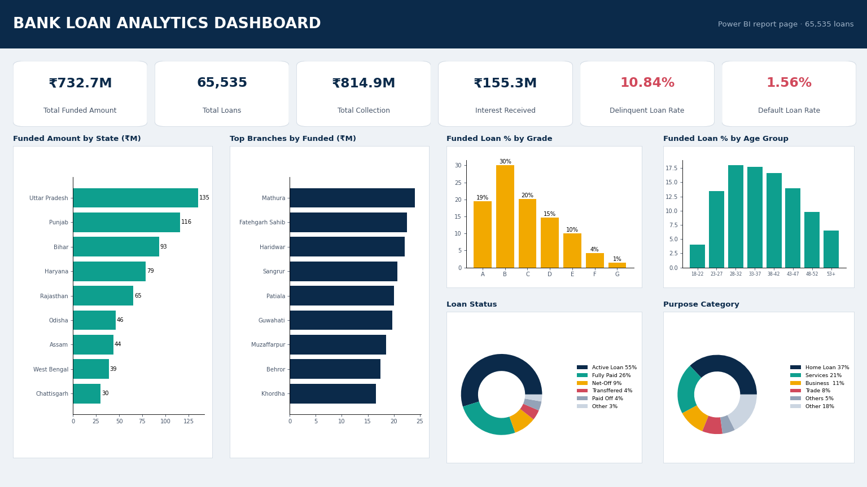
Dashboard: Bank Loan Analytics
How to read it
Top cards: size, collections and risk rates
Bars: funding by state and branch
Grade and age charts show borrower mix
Donuts: loan status and purpose
Dashboard preview rendered from the project data, following the Power BI page layout.

Slide 13
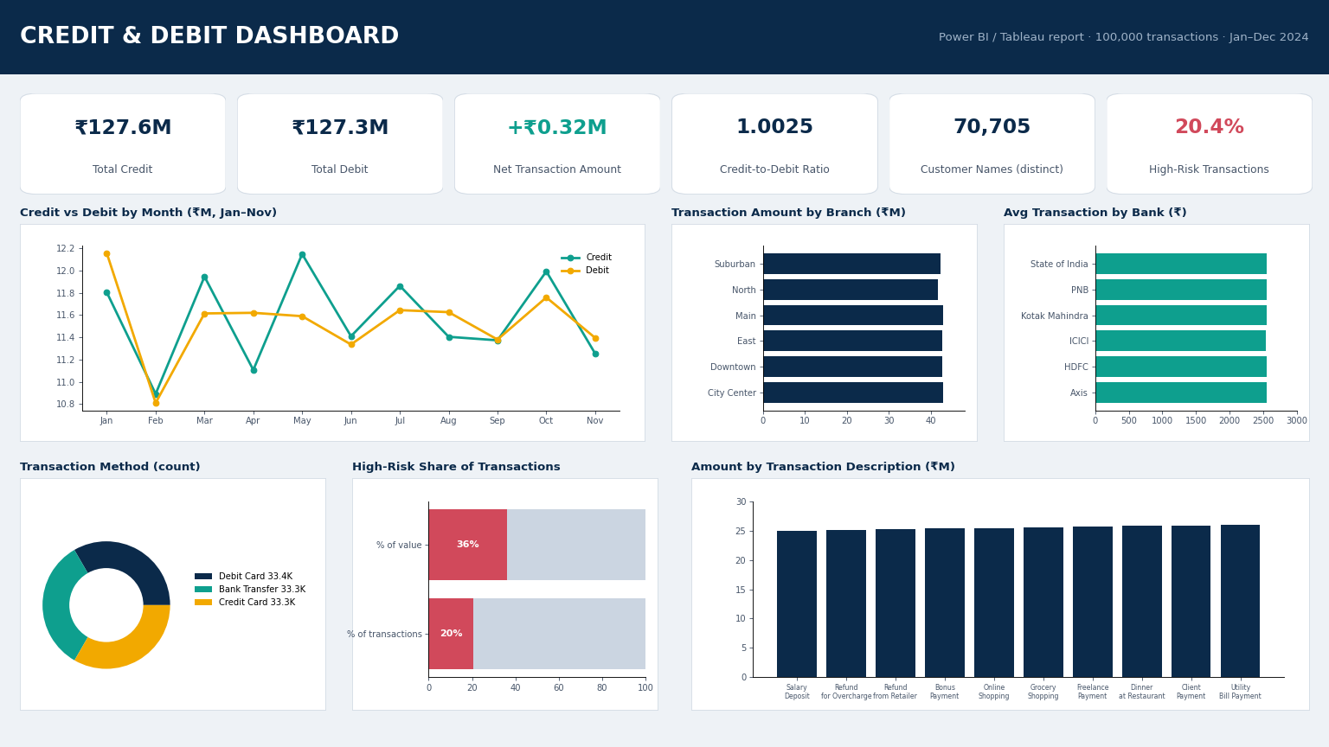
Dashboard: Credit & Debit
How to read it
Top cards: credit, debit, net flow and ratio
Lines: monthly credit vs debit
Bars: branch and bank comparison
Bottom row: method, risk share, description
Dashboard preview rendered from the project data, following the Power BI page layout.

